Slide 1
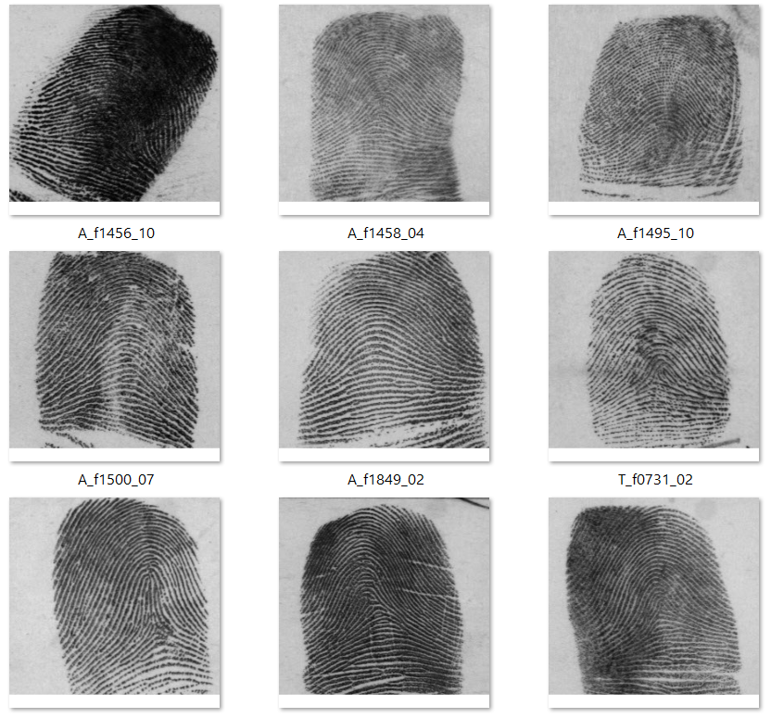
Fingerprint Recognition
By Nour Bassem 2022/00080
Image Processing Project

Slide 2
TABLE OF CONTENTS
01
02
03
Image Acquisition
Image Enhancement
Image Segmentation
04
05
06
Image Skeletonization
Feature Extraction
Feature Matching

Slide 3
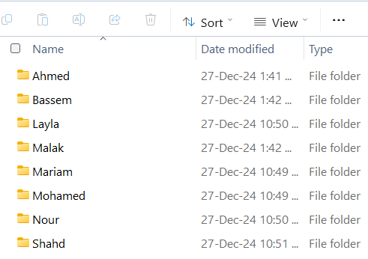
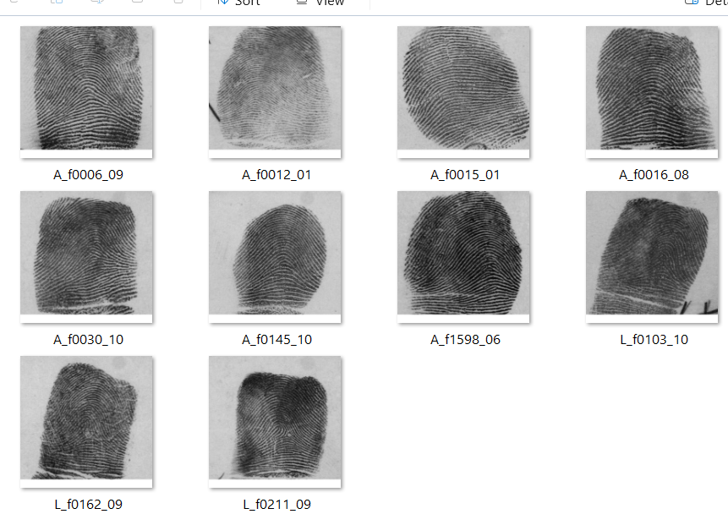
Image Acquisition/ Dataset
Project Proposal
By Slidego
01
My dataset consists of 10 folder (10 people) with each having 10 fingerprint images

Slide 4
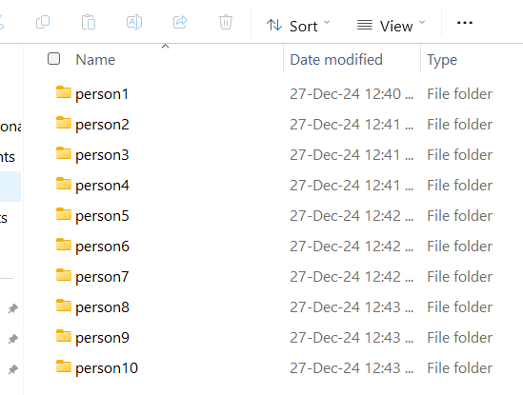
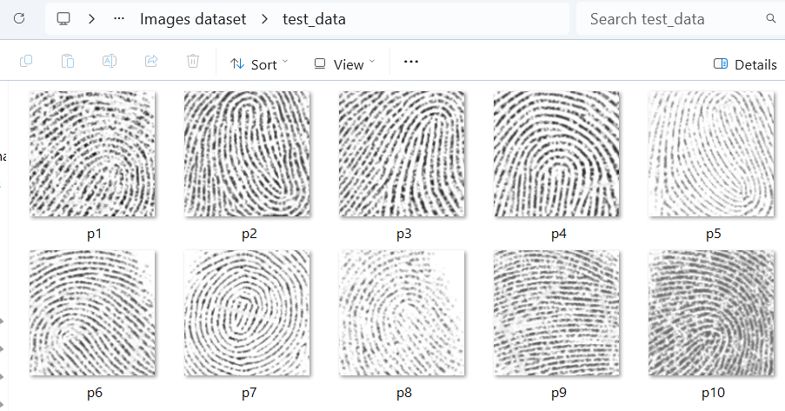
Dataset for train/test
Training set: 10 folders (one for each person), each containing 80 fingerprints.
Test set: Separate test file having 10 fingerprints(one for each) for evaluation.

Slide 5
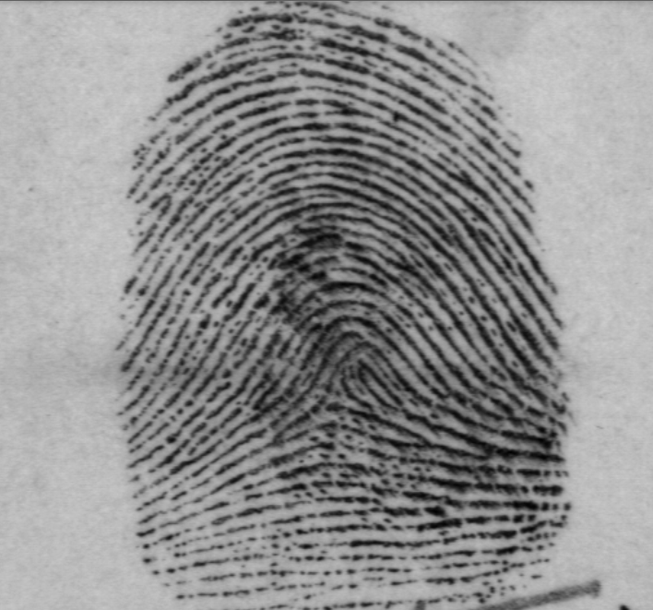
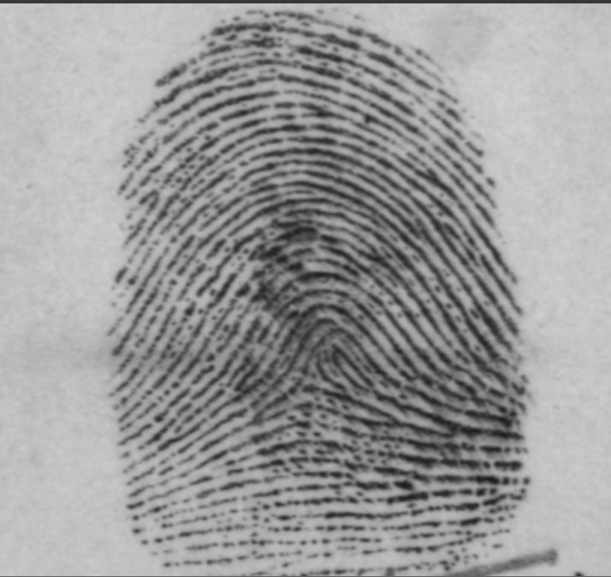
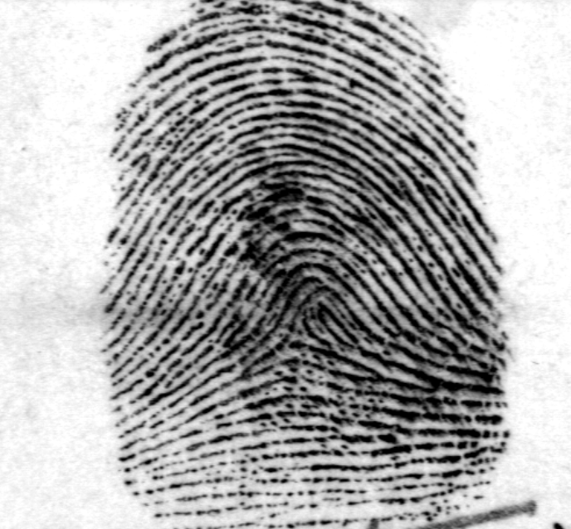
02 Image Enhancment/ Preprocessing
Contrast Stretching
Gaussian Blur for noise reduction.
Adaptive Thresholding for binarization
CLAHE (Contrast
Limited Adaptive Histogram Equalization)

Slide 6
03 Image Segmentation
Objective: Isolate the region of interest (ROI) in the fingerprint image
Remove noisy or irrelevant regions (background).
Identify and extract the fingerprint area using thresholding or masking techniques.
Normalize ROI to standard dimensions for further processing.

Slide 7
04 Image Skeletonization
Objective: Simplify fingerprint ridges to a one-pixel-wide skeleton
Convert the binarized image into a skeletonized version
Remove redundant pixels while preserving the fingerprint structure
Detect ridge endings and bifurcations

Slide 8
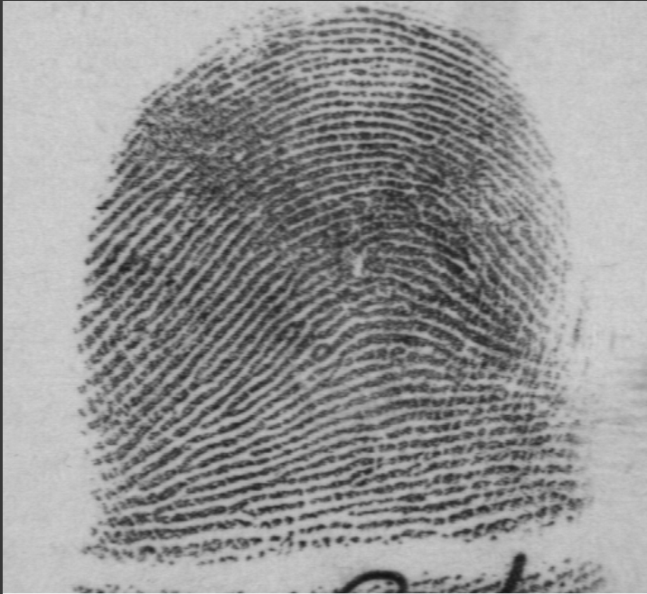
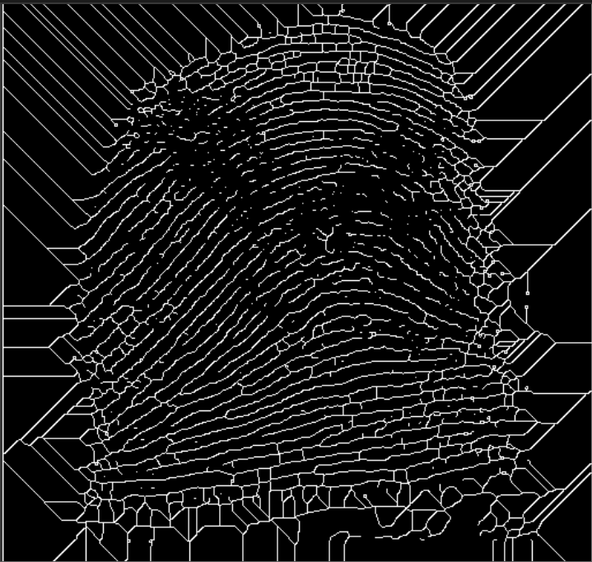
Before
Project Proposal
By Slidego
After

Slide 9
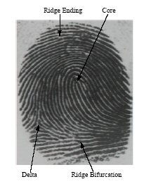










05 Feature Extraction
Output: A list of minutiae with their locations and orientations.
Minutiae Extraction Types of Minutiae:
Ridge endings.
Ridge bifurcations.
Process:
Analyze the neighborhood of each pixel in the skeletonized image.

Slide 10
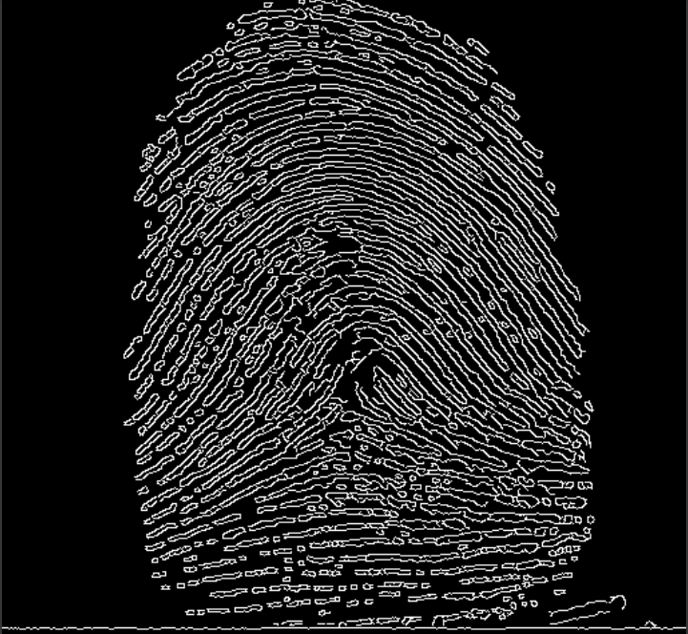
Extract numerical features for matching
Features:
Minutiae coordinates (x, y).
Orientation (angle).
Ridge density.
Technique: Store extracted features in a structured format (e.g., JSON or CSV).
Importance: Reduces fingerprint data to essential features for matching

Slide 11
06 Feature Matching
Goal: Compare test fingerprint features with stored templates to find a match
Steps:
Preprocess the test fingerprint.
Extract features (minutiae and orientation).
Compare with database templates using a similarity measure
(Cosine Similarity).
Matching Algorithm:
Calculate similarity scores.
Identify the closest match
(highest score).

Slide 12
Train/Test data
Models used:
K-Nearest Neighbors (KNN)
Support Vector Machine (SVM)
Random Forest
Model | Parameter | Best Value
KNN | n_neighbors | 5
 | metric | euclidean
SVM | C | 10
 | kernel | rbf
Random Forest | n_estimators | 100
 | max_depth | 10
Evaluate models:
KNN Accuracy: 31.25%
SVM Accuracy: 32.03%
Random Forest Accuracy: 41.88%
Testing on unseen fingerprint.

Slide 13
Thank You by Nour Bassem 2022/00080

